Slide 1
Project Proposal
Data Statistics SS 2022
Supervisor: Dr. Dinkelacker
Tutor: Ian Dirk Fichtner
Tissue restricted antigenes (TRAs) in embryonic mouse development
Alina Aksianova, Letizia Holube, Nina Bank, Lydia Steiner
Notes:
Lydia

Slide 2
Structure
biological background -literature
questions/hypotheses aim
QC and knowledge of the datasets
project structure, planned analysis and milestones
exploratory data analysis
Notes:
Lydia

Slide 3
Biological Background
Notes:
Lydia

Slide 4
TRAs
Tissue Restricted Antigenes
Central tolerance of the immune system = Negative Selection process
Developing T-Cells -> exposed to TRAs in thymus -> binding cells apoptosis
Defect: Auto immune diseases, e.g. Diabetes Type I
tra.2014.mouse.5x.table
ensembl.transcript | ensembl.gene | gene.symbol | entrezID | refseqID | unigeneID | chrom | startsite | tiss.number | tissues | max.tissue
ENSMUST00000000003 | ENSMUSG00000000003 | Pbsn | 54192 |  |  | X | 77837901 | 1 | prostate | prostate
Dinkelacker, 2007
Dinkelacker, 2019
Notes:
Lydia

Slide 5
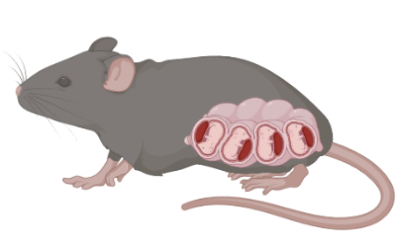
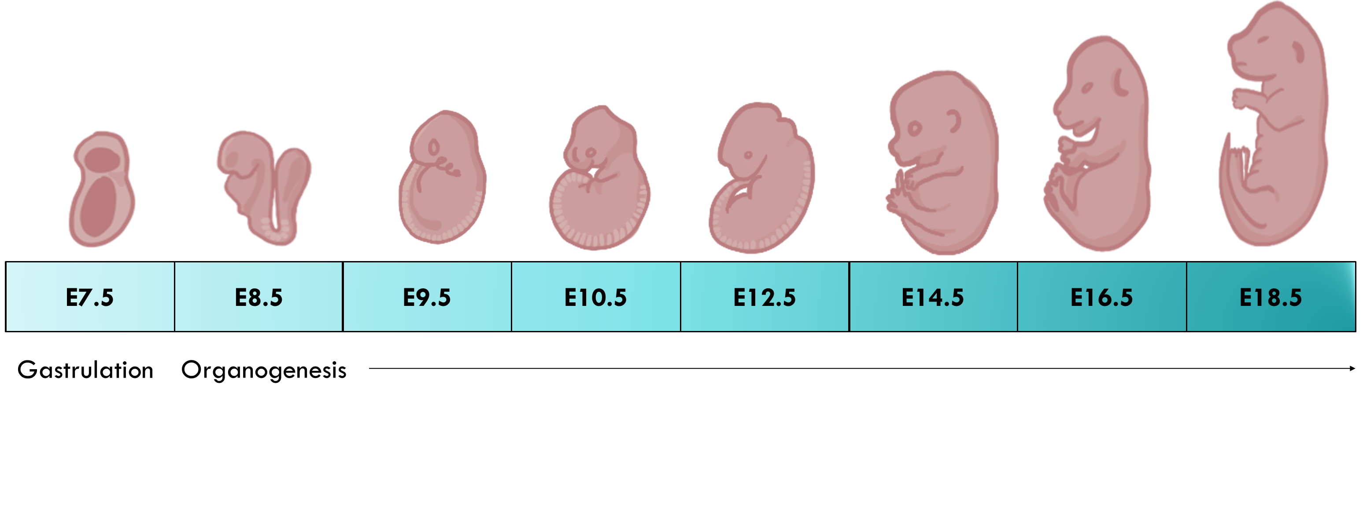
Embryonic Development
Lung primordium
Lung
Heart
Liver
Thymus
Notes:
Nina

Slide 6
Dataset
Notes:
Letizia

Slide 7
Dataset
What did we choose, why did we choose it
Irie, N., & Kuratani, S. (2011). Comparative transcriptome analysis reveals vertebrate phylotypic period during organogenesis. Nature communications, 2, 248. https://doi.org/10.1038/ncomms1248
Gene Expression in mouse embryo development
Intervals: E7.5, E8.5, E9.5, E10.5, E12.5, E14.5, E16.5, E18.5 (days after mating)
each containig 2-3 samples with RNA of multiple whole embyos
Notes:
Phylotypic stage: developmental period in mid-embryogenesis where related species within a phylum (Tierstamm), highest resemblance
Datensatz erklären können

Slide 8
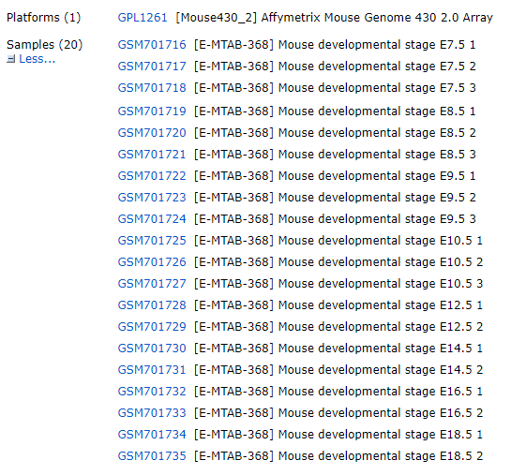
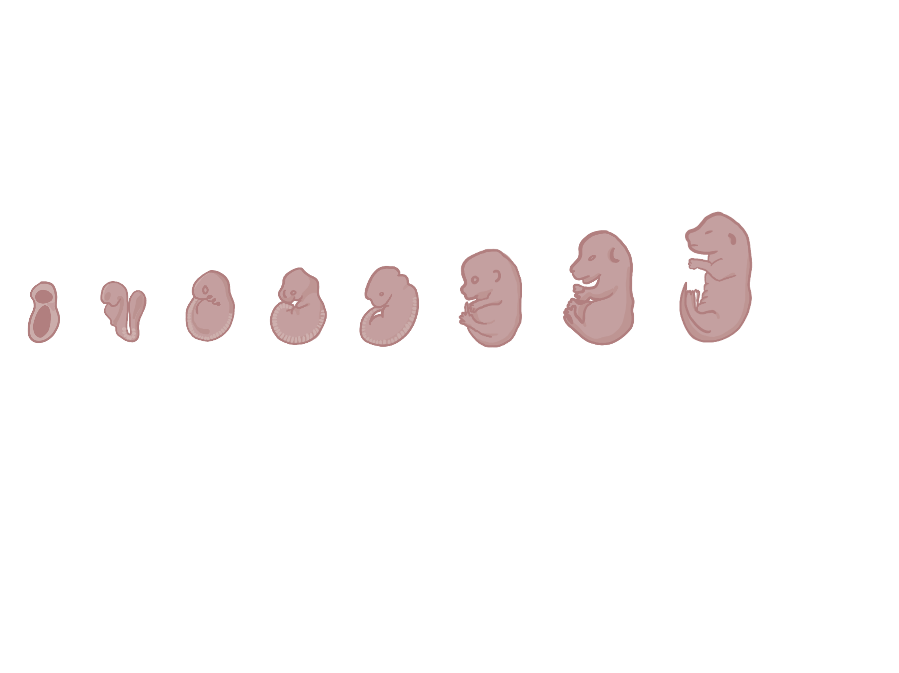
Structure of the data
20 Chips in total
E7.5
E7.5
E7.5
E12.5
E12.5
E8.5
E8.5
E8.5
E14.5
E14.5
E9.5
E9.5
E9.5
E16.5
E16.5
E10.5
E10.5
E10.5
E18.5
E18.5
E.7.5 Embrionic Day 7.5

Slide 9
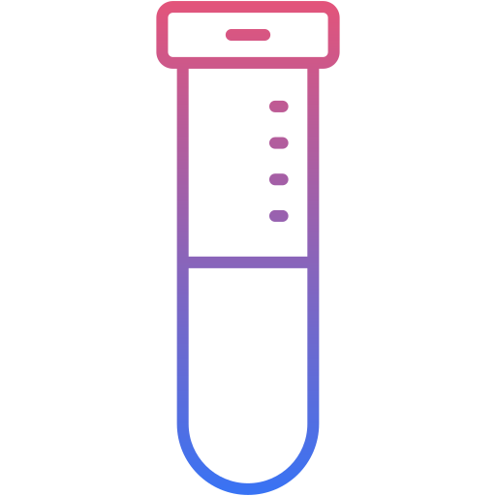


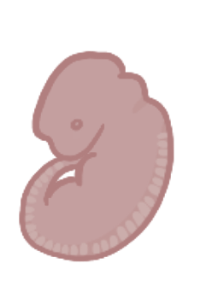


Dataset
Embryo (E7.5 – E18.5)
Mouse Genome 430 2.0 Array
C57BL/6 Mouse
RNA
E.7.5 Embrionic Day 7.5
<a href="https://www.flaticon.com/de/kostenlose-icons/blutschlauch" title="blutschlauch Icons">Blutschlauch Icons erstellt von Vector Squad - Flaticon</a>
Created with BioRender.com
Notes:
? Wie ist dieser Micro Array aufgebaut?
? Was wurde wohin pipettiert (1 Maus auf 1 Array? 1 Maus in 1 Well?) Mice usually bear 6-8 pups during pregnancy. For representation (?) only one was extracted per mouse.
To examine the transcriptome of the mouse embryo, the extracted embryo was homogenized and RNA was extracted for microarray analysis. (The mouse model was C57BL/6 and the specific microarray was Affymetrix Mouse Genome 430 2.0 Array) (For each stage 2 or 3 embryos were extracted for biological replication)

Slide 10
Quality Control
Notes:
Lydia

Slide 11
QC - Single Chip Control

Slide 12
QC - Normalization
Via vsnrma: Variance stabilization and calibration for microarray data

Slide 13
QC – RNA Degradation

Slide 14
QC – Scatter Plot
1 | 2
2 | 3
3 | 4
4 | 5
5 | 6
6 | 7
7 | 8
... | ...

Slide 15
Exporatory Data Analysis
Notes:
Alina

Slide 16
Exploratory Data Analysis
Histogramme
Density plots
Notes:
Alina

Slide 17
Hypothesis and Milestones
Notes:
Letizia

Slide 18
Our main ambition
Hauptziel: Analyse the differential expression levels of TRAs change over time of mouse embryogenesis
Netter Zusatz: If we find significant changes in the expression of TRA => Analyse in which stadium which organs develops
Zweites: Whether there is a correlation with Chemokines
Notes:
Letizia

Slide 19
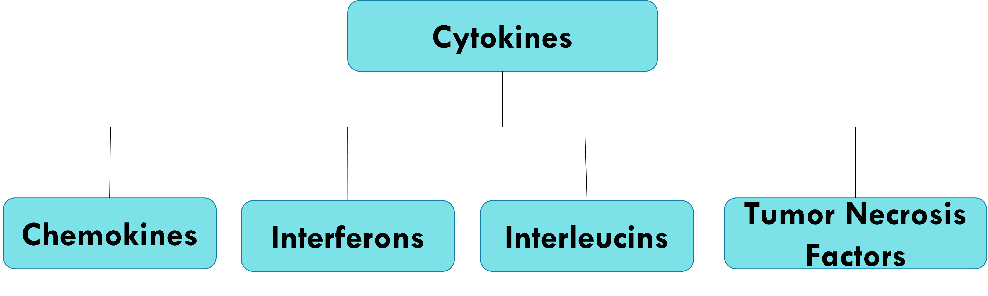
Chemokines
CCL
CXC
Notes:
Chemokines are a subset of signaling molecules, which can also be called cytokines. While cytokines describe signaling molecules in general, chemokines describe signaling molecules that guide a cell in a specific direction, also reffered to as chemotaxis. This is majorly observed in immune response, but also occurs during embryogenesis during cell migration. There are two major families of chemokines, the CC family and the CXC family. You will find abbreviations such as CCL and CCR, the L stands for ligand, this means CCL is a chemokine. R stands for receptor, this means this protein is a receptor for either CC or CXC chemokine. As for CC chemokines, they tend to induce migration of lympohhcytes and monocytes.CCL2 for example promotes Th2 immunity and release of histamine.
Then there are CXC chemokines. These tend to promote neutrophil migration and they include the following: - CXCL8 (IL-8) for recruitment to infected tissue - CXCL12 for migration of germ cells.

Slide 20
What have we done until now?
Week 1
Week 2
Week 3
19.05. 2022
Data Camp
Github
Organisation
Dataset selection
Quality Control
Literature Research
Data Exploration
Project Proposal
Notes:
Nina

Slide 21
Timeline
Week 1
Week 2-3
Week 4-6
Week 7-8
13.07. 2022
Further Data Exploration
Data Cleanup
Final touches on Github
Biostatistic analyses:
PCA, heatmaps
k-means
differential gene expression
TRA and chemokine analyses
Compare to literature
Bug Fixes
Finish presentation and report
Final Presentation
Notes:
Nina

Slide 22
Literature
Dinkelacker 2019. Chromosomal clustering of tissue restricted antigens, Dissertation, University Heidelberg, Germany.
Dinkelacker 2007. A database of genes that are expressed in a tissue-restricted manner to analyse promiscous gene expression in medullary thymic epithelial cells. Diplomarbeit, Albert-Ludwigs-Universitaet, Freiburg, Germany.
Irie, N., Kuratani, S. Comparative transcriptome analysis reveals vertebrate phylotypic period during organogenesis. Nat Commun 2, 248 (2011). https://doi.org/10.1038/ncomms1248
Kyewski, B., & Klein, L. (2006). A central role for central tolerance. Annual review of immunology, 24, 571–606. https://doi.org/10.1146/annurev.immunol.23.021704.115601
Kyewski et al. 2004, Self-representation in the thymus: an extended view, Nat. Rev. Immunol. 2004 Sep, 4 (9) 699-698. https://pubmed.ncbi.nlm.nih.gov/15343368/
Atkinson, M.A., Eisenbarth, G.S. and Michels, A.W. (2014) Type 1 Diabetes. Lancet, 383, 69-82. https://doi.org/10.1016/S0140-6736(13)60591-7
Srinivasan, Shardha, et al. "Noninvasive, in utero imaging of mouse embryonic heart development with 40-MHz echocardiography." Circulation 98.9 (1998): 912-918.
Zong, Yiwei, and Joshua R. Friedman. "Liver development." Liver Disease in Children (2014): 1-813.
Ten Have-Opbroek, Ank AW. "Lung development in the mouse embryo." Experimental lung research 17.2 (1991): 111-130.
Holländer, Georg, et al. "Cellular and molecular events during early thymus development." Immunological reviews 209.1 (2006): 28-46.

Slide 23
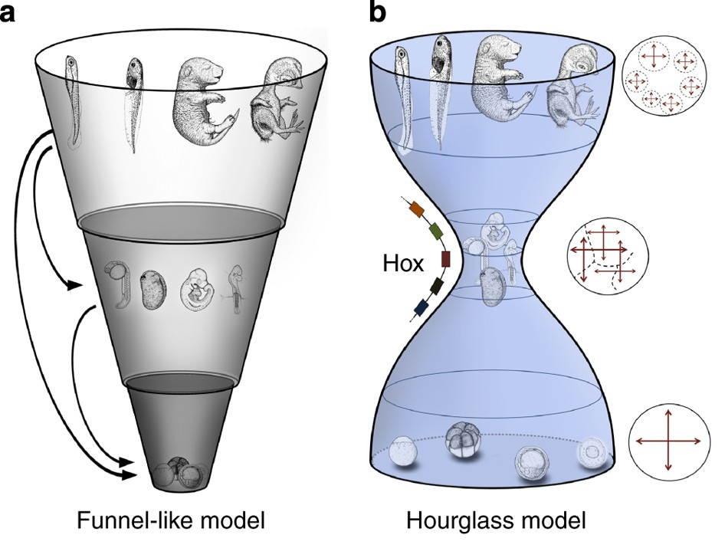
Extraslide
The paper of the dataset
Comparison of the transcriptome during phylotypic period of multiple vertebrates
Two theories for development
Funnel-like model: increasing diversity over time
Hourglass model: mid-embryonic stages (organogenesis) are more evolutionarily conserved
Irie, N., Kuratani, S. Comparative transcriptome analysis reveals vertebrate phylotypic period during organogenesis. Nat Commun 2, 248 (2011). https://doi.org/10.1038/ncomms1248
Notes:
Nina

Slide 24
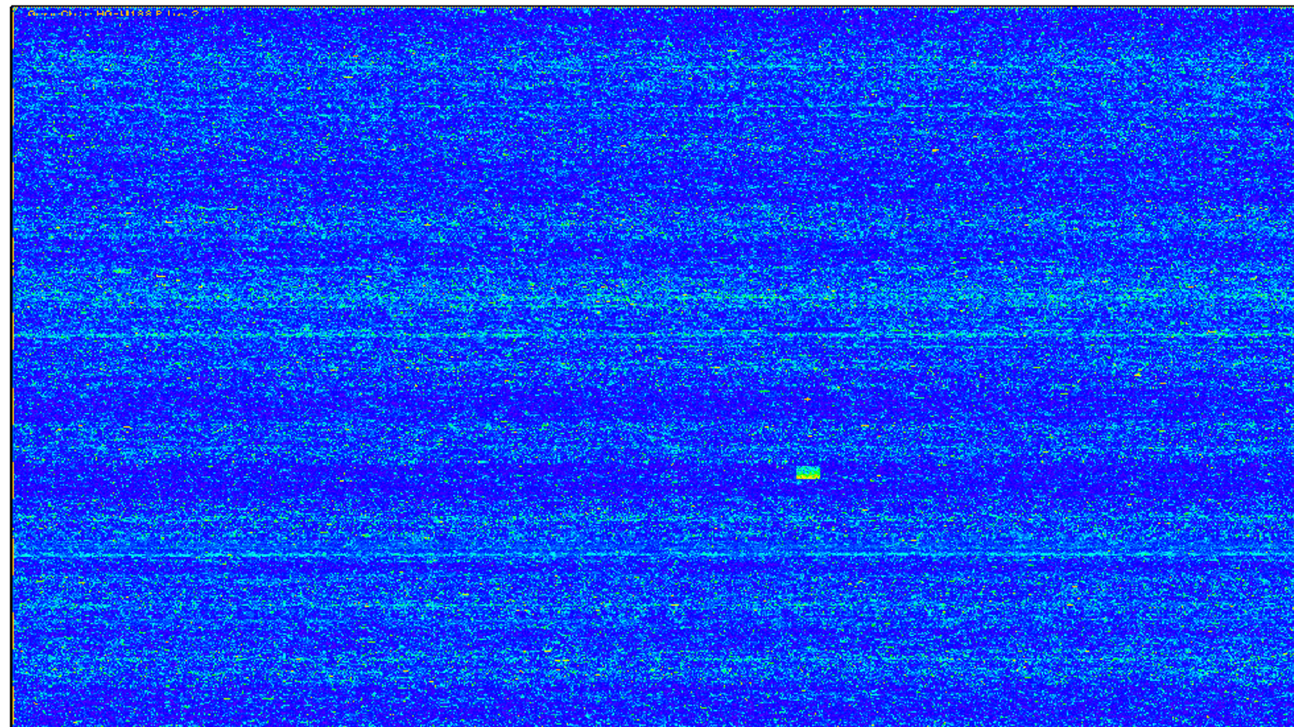
How do Microarrays work?
Gene Chip that reads gene expression in form of RNA
RNA -> cDNA -> labelling -> Hybridisation -> Scanning -> Data Acquisition
Labelling via biotin or Fluorescence
Brand of chip: Affymetrix Mouse Genome 430 2.0 Array
Internal Quality Control

Slide 25
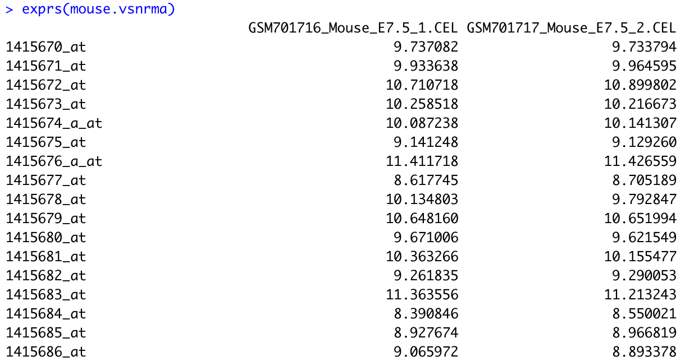
This is what our Dataset looks like
Notes:
Alina/Lydia

Slide 26
Methods for Quality Control
RNA degradation plot for quality control
VSNrma Normalisation
Boxplot before and after normalisation
If necessary Quantile normalisation
Scatter plot to control chip quality

Slide 27
Mean SD Plot

